Slide 2
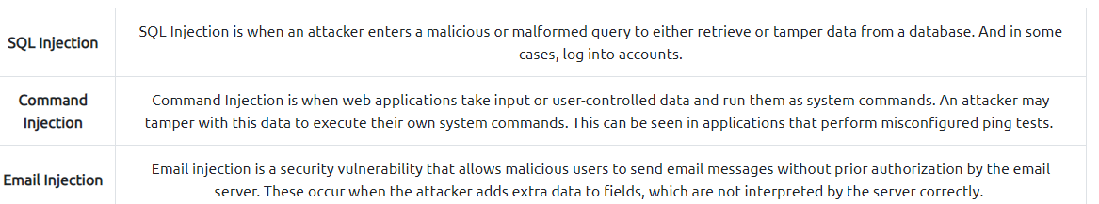
Helo
In this task, we will look at exploiting authentication through different flaws. When talking about flaws within authentication, we include mechanisms that are vulnerable to manipulation. These mechanisms, listed below, are what we will be exploiting.
Weak passwords in high privileged accounts
Forgotten password pages
More information: Broken Authentication

Slide 3
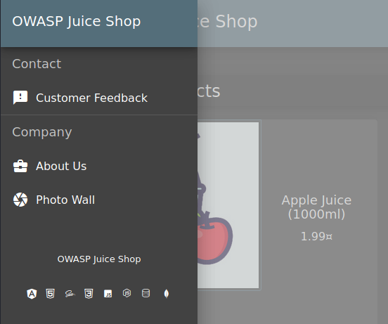
Question #2: Reset Jim's password! Believe it or not, the reset password mechanism can also be exploited! When inputted into the email field in the Forgot Password page, Jim's security question is set to "Your eldest siblings middle name?“
AH! Don't look!
Most of the time, data protection is not applied consistently across the web application making certain pages accessible to the public. Other times information is leaked to the public without the knowledge of the developer, making the web application vulnerable to an attack.
Look About us page.

Slide 4
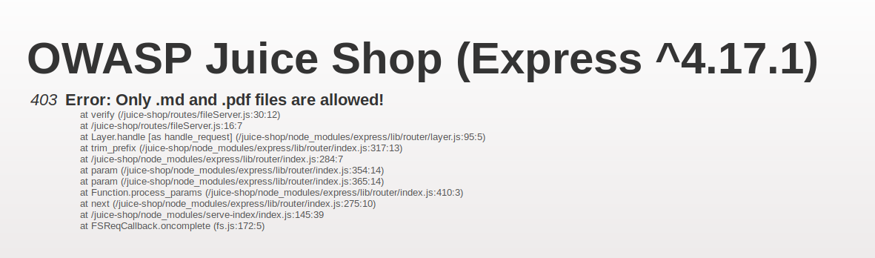
Question #3: Download the Backup file!
We will now go back to the http://10.10.232.174/ftp/ folder and try to download package.json.bak. But it seems we are met with a 403 which says that only .md and .pdf files can be downloaded.
To get around this, we will use a character bypass called "Poison Null Byte". A Poison Null Byte looks like this: %00.
Note: as we can download it using the url, we will need to encode this into a url encoded format.
The Poison Null Byte will now look like this: %2500. Adding this and then a .md to the end will bypass the 403 error!
Why does this work?
A Poison Null Byte is actually a NULL terminator. By placing a NULL character in the string at a certain byte, the string will tell the server to terminate at that point, nulling the rest of the string.

Slide 5
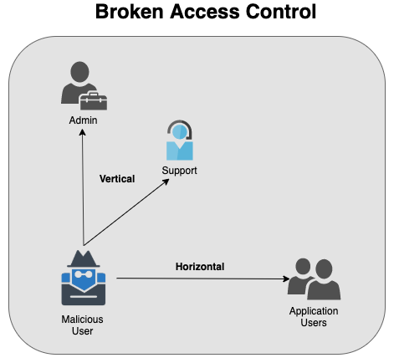
Modern-day systems will allow for multiple users to have access to different pages. Administrators most commonly use an administration page to edit, add and remove different elements of a website. You might use these when you are building a website with programs such as Weebly or Wix.
When Broken Access Control exploits or bugs are found, it will be categorised into one of two types

Slide 6
Question #1: Access the administration page!
First, we are going to open the Debugger on Firefox.
(Or Sources on Chrome.)
This can be done by navigating to it in the Web Developers menu.
We are then going to refresh the page and look for a javascript file for main-es2015.js
We will then go to that page at: http://MACHINE_IP/main-es2015.js
This hints towards a page called "/#/administration" as can be seen by the about path a couple lines below, but going there while not logged in doesn't work.
As this is an Administrator page, it makes sense that we need to be in the Admin account in order to view it.
A good way to stop users from accessing this is to only load parts of the application that need to be used by them. This stops sensitive information such as an admin page from been leaked or viewed.
Question #2: View another user's shopping basket!
Login to the Admin account and click on 'Your Basket'. Make sure Burp is running so you can capture the request!
Forward each request until you see: GET /rest/basket/1 HTTP/1.1
ow, we are going to change the number 1 after /basket/ to 2

Slide 7
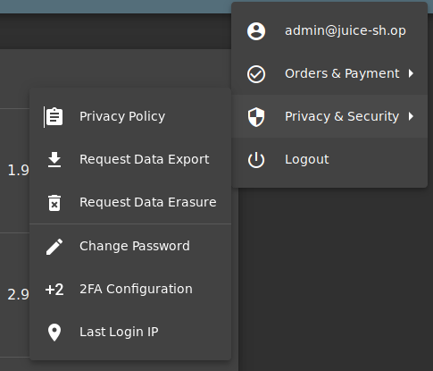
Question #1: Perform a DOM XSS!
We will be using the iframe element with a javascript alert tag: <iframe src="javascript:alert(`xss`)">
This type of XSS is also called XFS (Cross-Frame Scripting), is one of the most common forms of detecting XSS within web applications.Websites that allow the user to modify the iframe or other DOM elements will most likely be vulnerable to XSS.
Why does this work? It is common practice that the search bar will send a request to the server in which it will then send back the related information, but this is where the flaw lies. Without correct input sanitation, we are able to perform an XSS attack against the search bar.
Question #2: Perform a persistent XSS!:
First, login to the admin account.
We are going to navigate to the "Last Login IP" page for this attack

Slide 8
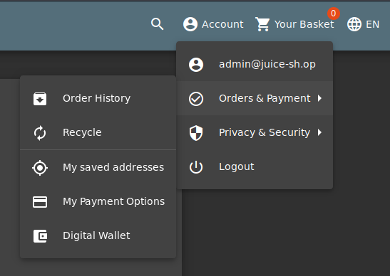
As it logs the 'last' login IP we will now logout so that it logs the 'new' IP.
Make sure that Burp intercept is on, so it will catch the logout request.
We will then head over to the Headers tab where we will add a new header:
True-Client-IP:<iframe src="javascript:alert(`xss`)">
Then forward the request to the server! When signing back into the admin account and navigating to the Last Login IP page again, we will see the XSS alert!
The True-Client-IP header is similar to the X-Forwarded-For header, both tell the server or proxy what the IP of the client is. Due to there being no sanitation in the header we are able to perform an XSS attack.
Question #3: Perform a reflected XSS!
First, we are going to need to be on the right page to perform the reflected XSS!
Login into the admin account and navigate to the 'Order History' page

Slide 9
From there you will see a "Truck" icon, clicking on that will bring you to the track result page. You will also see that there is an id paired with the order.
We will use the iframe XSS, <iframe src="javascript:alert(`xss`)">, in the place of the 5267-f73dcd000abcc353

